Slide 1
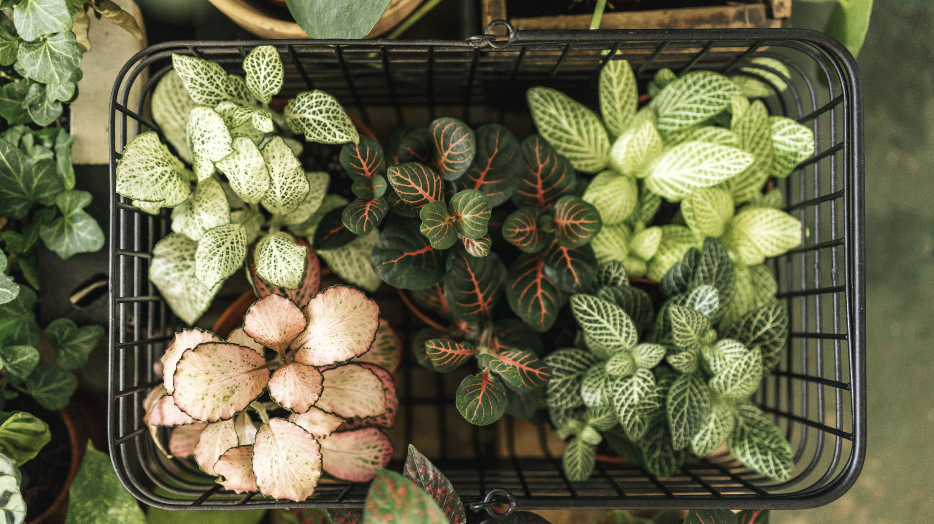
Carolina’s Etsy Plant Store
CFG: Data and SQL Final Course Project Carolina Toste
https://github.com/Carolina-Toste

Slide 2
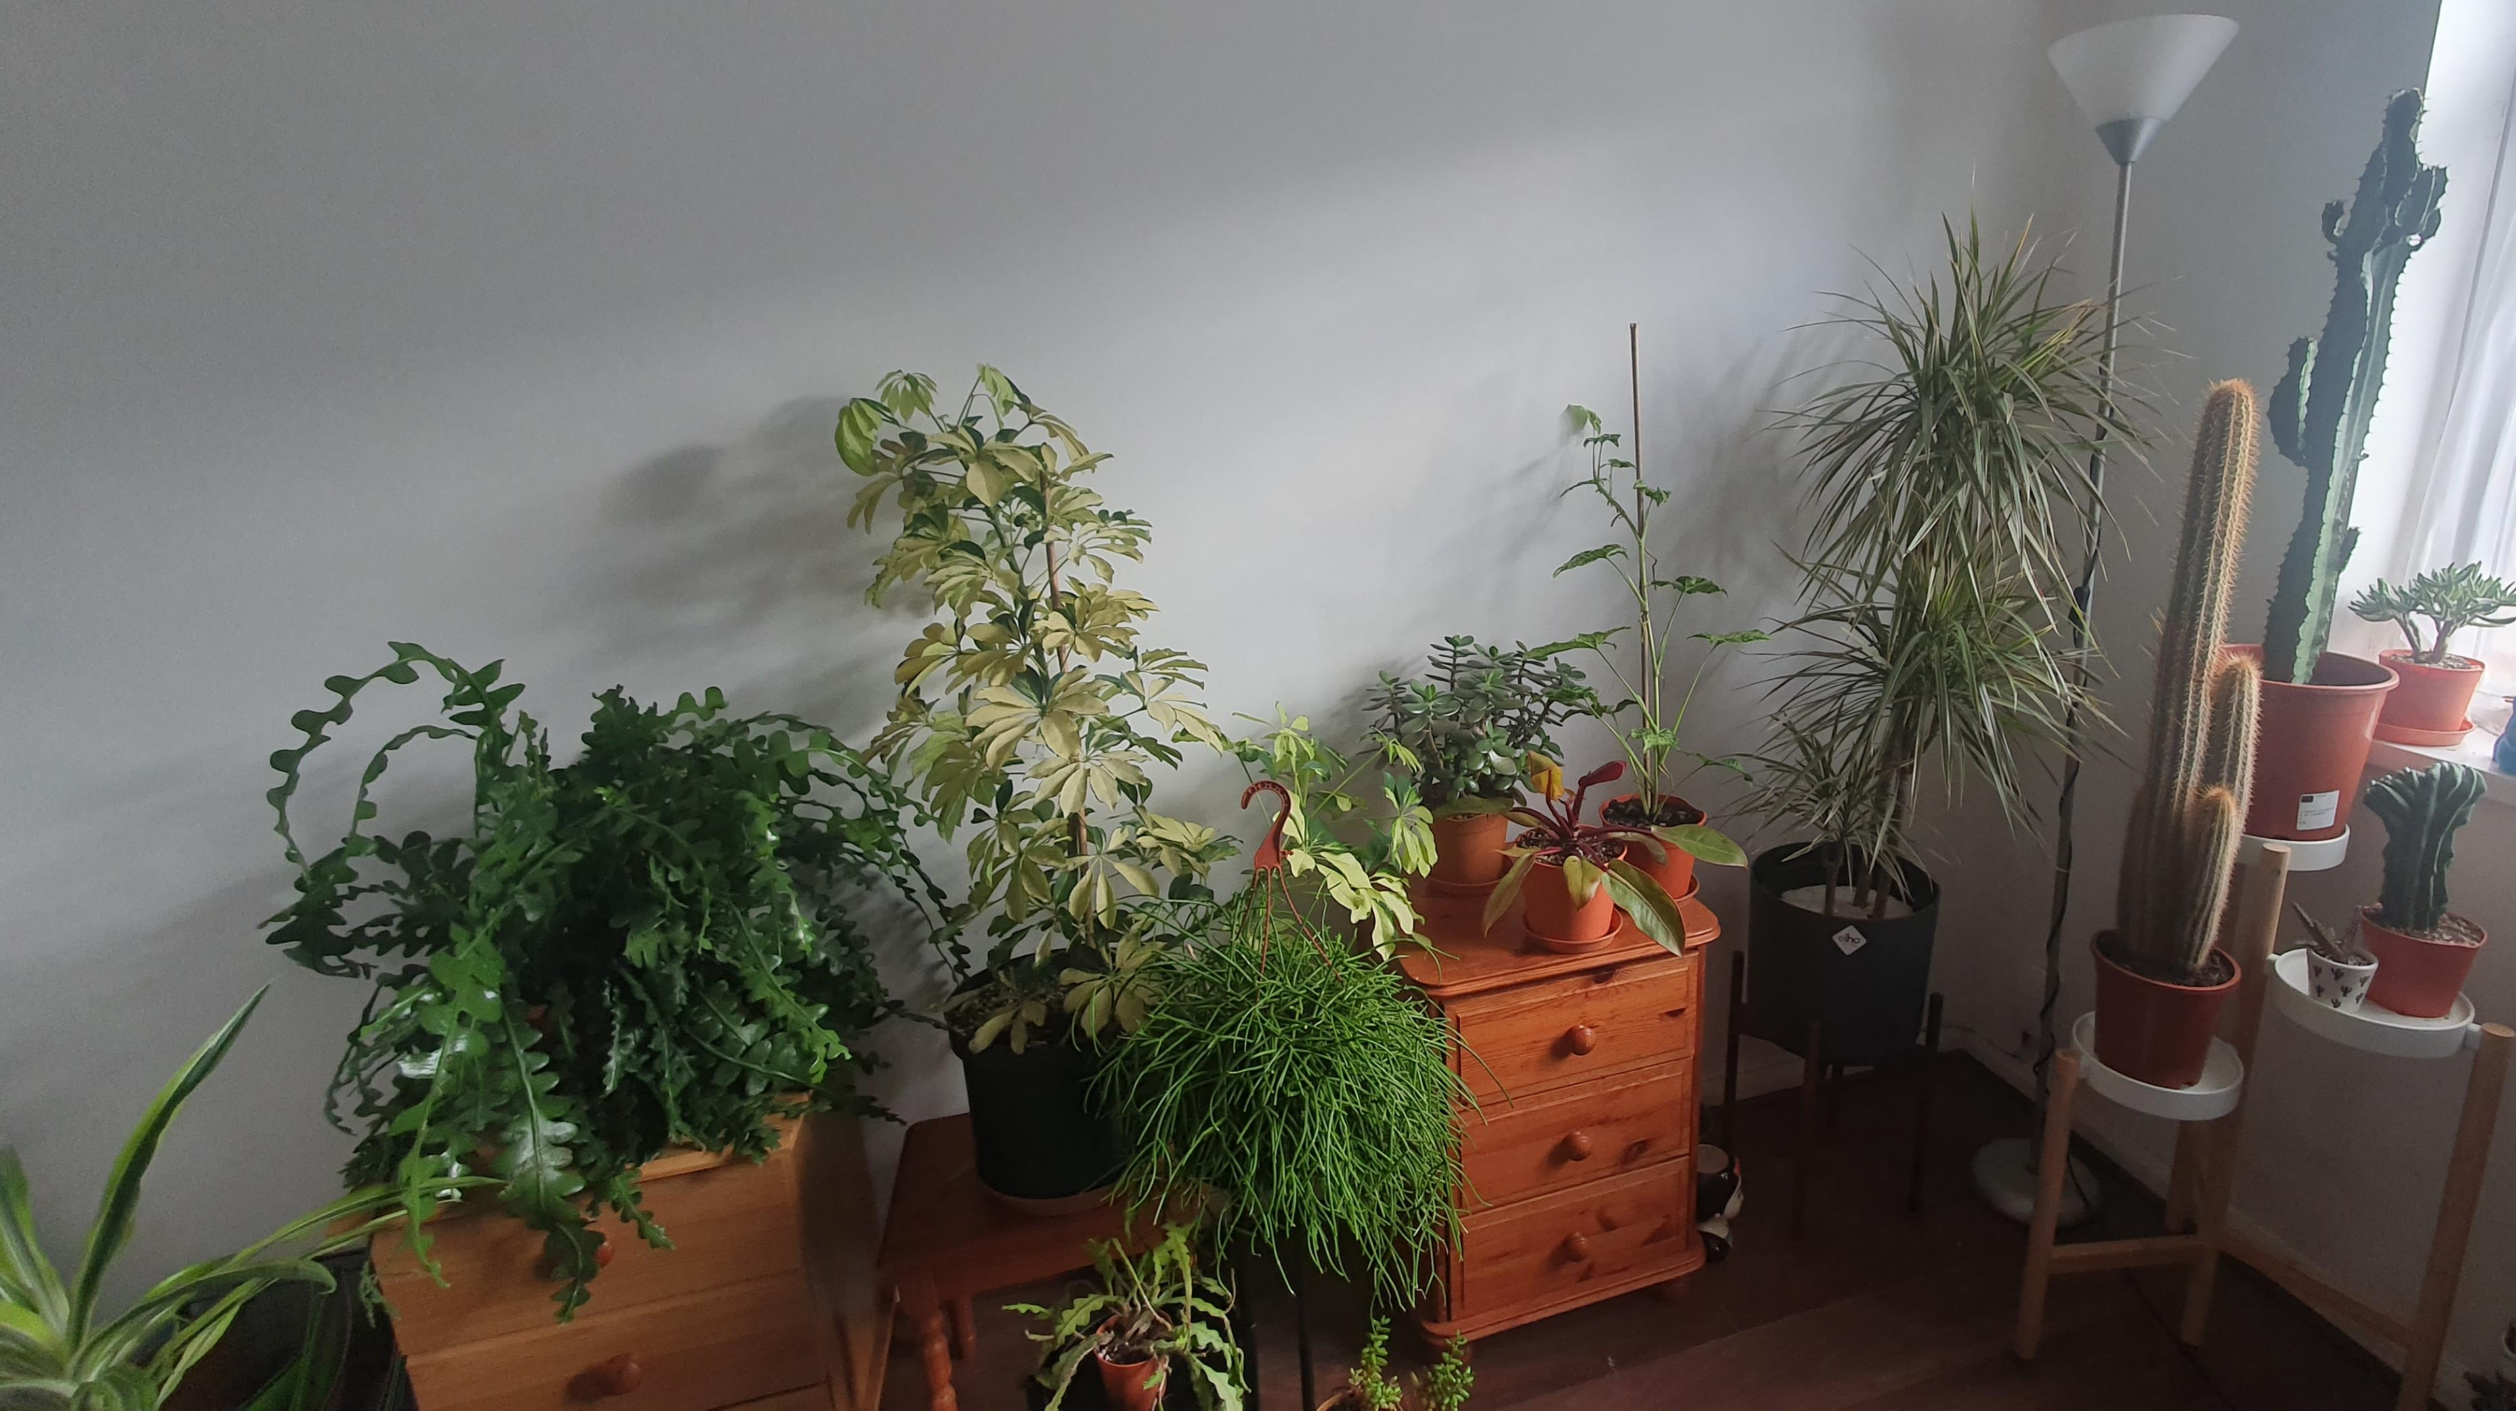
Database containing orders and stock for an online plant store

Slide 3
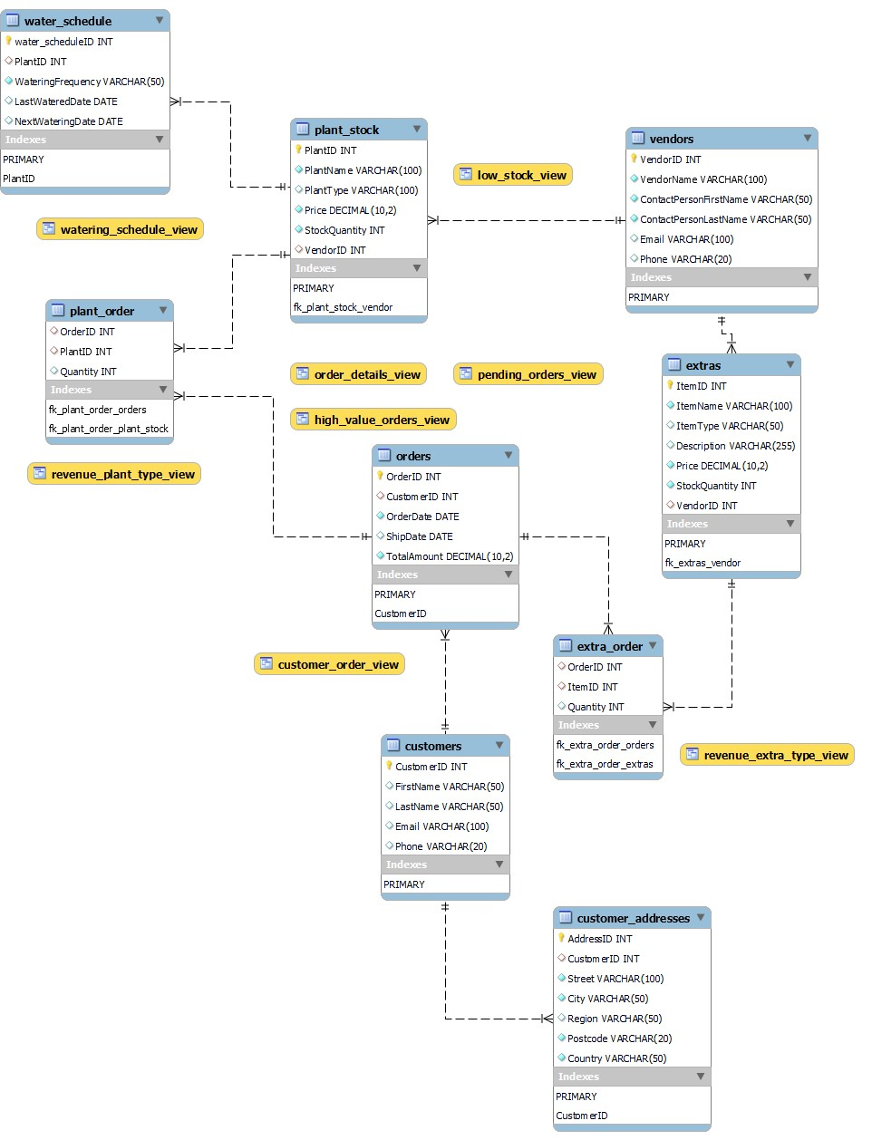
The plants db
Tables:
Plant_stock
Water_schedule
Vendors
Extras
Orders
Plant order
Extra order
Customers
Customer_addresses

Slide 4
Demo

